Slide 1
Stock Trading Strategy with Machine Learning and Backtrader
Leveraging XGBoost and Random Forest for Predictive Trading

Slide 2
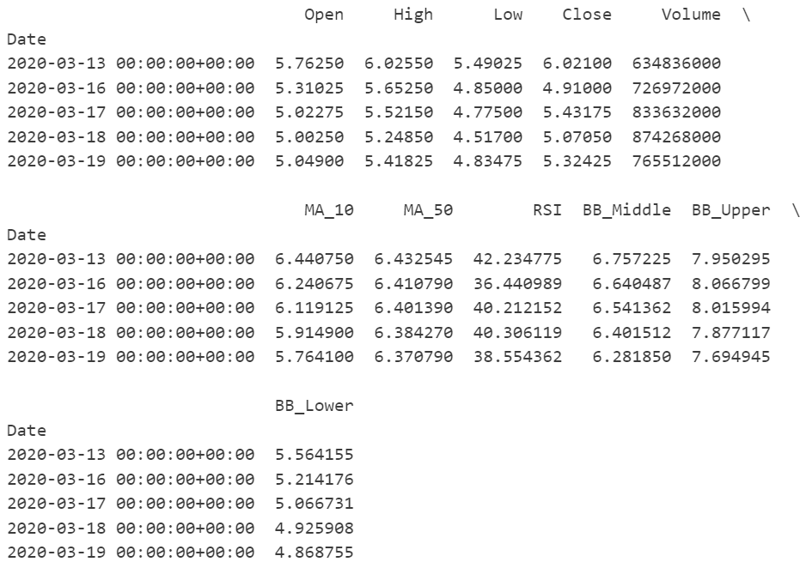
Objective: Create a predictive trading strategy using machine learning models (XGBoost & Random Forest) and Backtrader for risk-managed backtesting.
Key Steps:Data preprocessing with technical indicators.
Train XGBoost and Random Forest models.
Implement strategy using Backtrader with risk management.

Slide 3


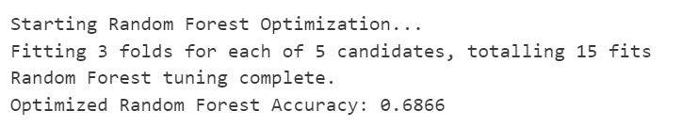
Data Preprocessing
Features: We use a combination of technical indicators:
Moving Averages (MA), RSI, MACD, ATR, etc.
Sentiment Proxy: Market sentiment.
Lag Features: Past data like RSI_Lag_1 and MACD_Lag_1.
Target: 3-day forward prediction (1 if price goes up, 0 if it goes down).
Scaling: Standardization using StandardScaler.

Slide 4
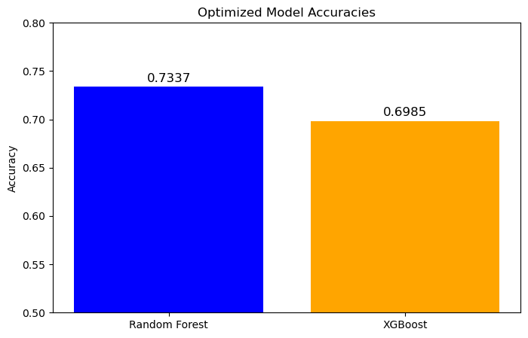
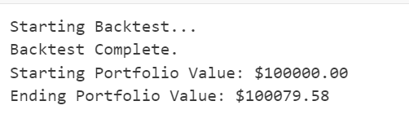
Optimized Model Accuracies

Slide 5
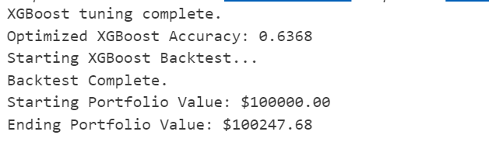
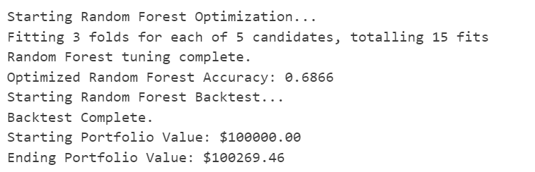
Model Training
XGBoost Model:
Hyperparameter tuning with RandomizedSearchCV.
Trained on features and evaluated using accuracy.
Random Forest Model:
Similar tuning and evaluation process.
Comparison of model performance based on accuracy.

Slide 6
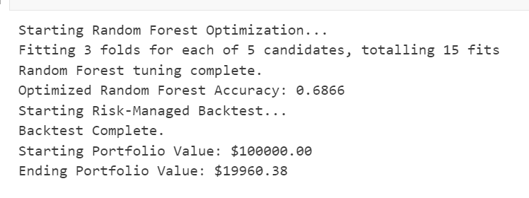
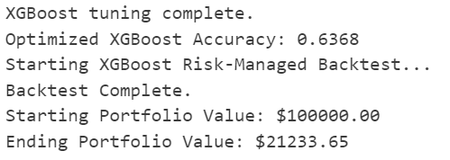
Backtrader Strategy
Risk Management:
Stop-loss and take-profit based on ATR (Average True Range).
Position size limited to 15% of capital to avoid over-leveraging.
Confidence Threshold:
Buy when model confidence is > 70%.
Sell if confidence drops below a threshold.
Execution: Both models predict market movements, guiding the strategy.
Random Forest
XRGBoost

Slide 7
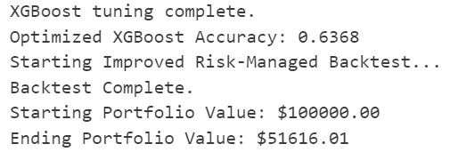
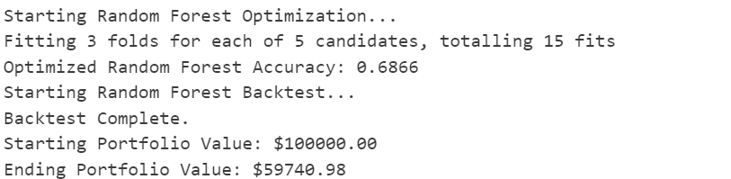
Backtesting
Parameters:
Initial cash: $100,000.
Transaction costs: 0.4% commission and 0.2% slippage.
Result: A machine learning-driven strategy shows potential for predictive trading, incorporating strong risk management techniques.
XGBoost
Radom Forest

